Slide 1
The ”””Avengers”””
Duncan (s3718718)
Mohammed (s3756190)
Thien (s3714217)
Tharvind (s3654959)
Saad (s3690439

Slide 2
Our Product

Slide 3

Our Product
Our products aims to help users keep track of their schedule by adding their events to a calendar.
The calendar itself shows the current date to the user and allows them to navigate to other days, months and years.
To ensure each user is able to have their own personal calendar for their own schedules, they have to exist in our database.
In order to distinguish users, we validate that user exists within our database and that the user is the correct user of that calendar.
This validation includes login credentials and specific login parameters for account creation.

Slide 4
Calendar API features

Slide 5
Calendar API features
Features
Calendar
View in month format
Select day
Current day highlighted
Make event
Switch month
Select month
Switch year

Slide 6
Calendar API features
Features
Event Creation
Input field validation
All fields must be filled in
Date: Must be in proper format (yyyy-mm-dd)
Location: Must meet adequate input length
Description: Must meet adequate input length
Title: Must meet adequate input length

Slide 7
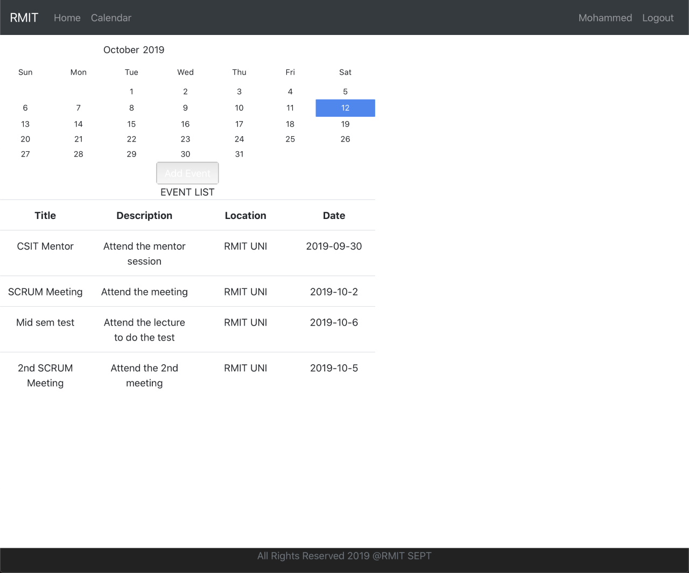

Slide 8
Central Authentication API features

Slide 9
Central Authentication API features
Features
Login
User authentication via credentials (Username, Password)
Forgot password feature
Security questions to reset password
Resetting password requires user to confirm their password in separate input field
Registration
Input field validation
All fields must be filled in
Email: Must follow email regex
Password: Must meet adequate input length
Security Questions: Must meet adequate input length
Password and Confirm password fields: Must match

Slide 10
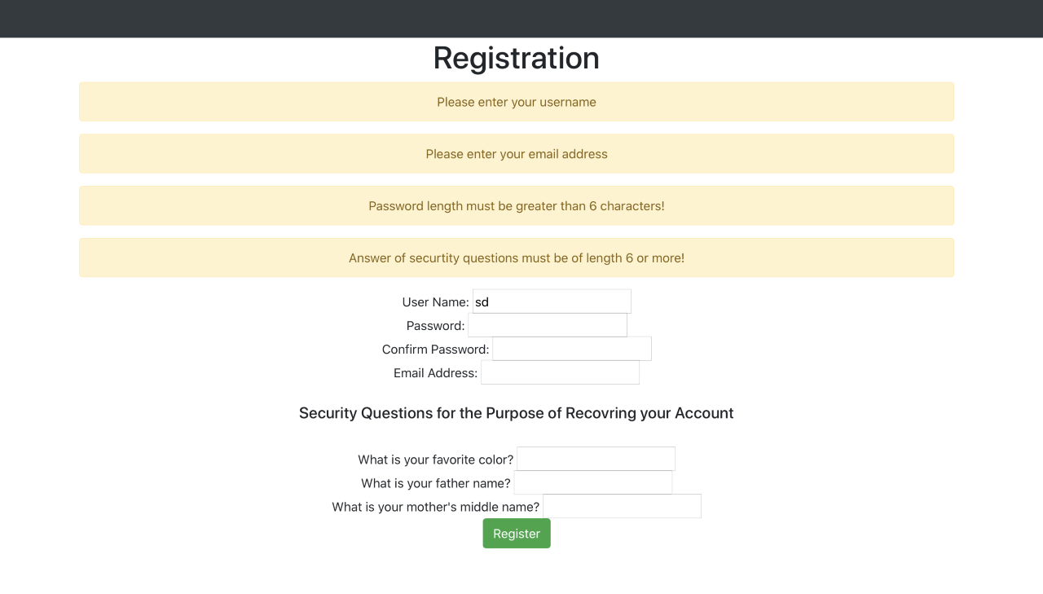

Slide 11
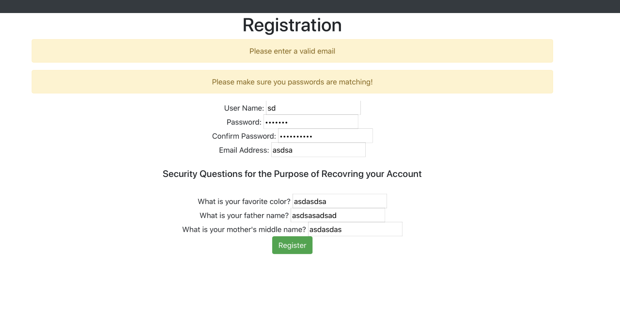

Slide 12
User Flow

Slide 14
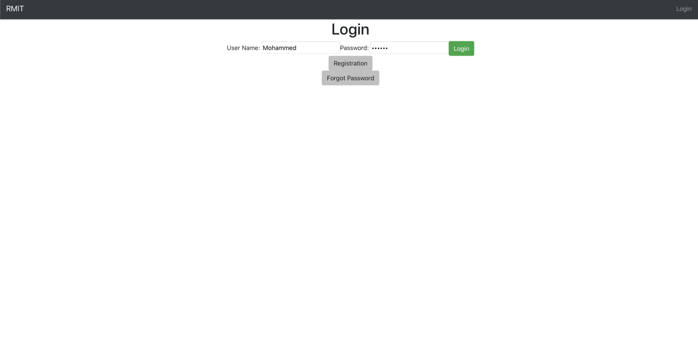

Slide 15
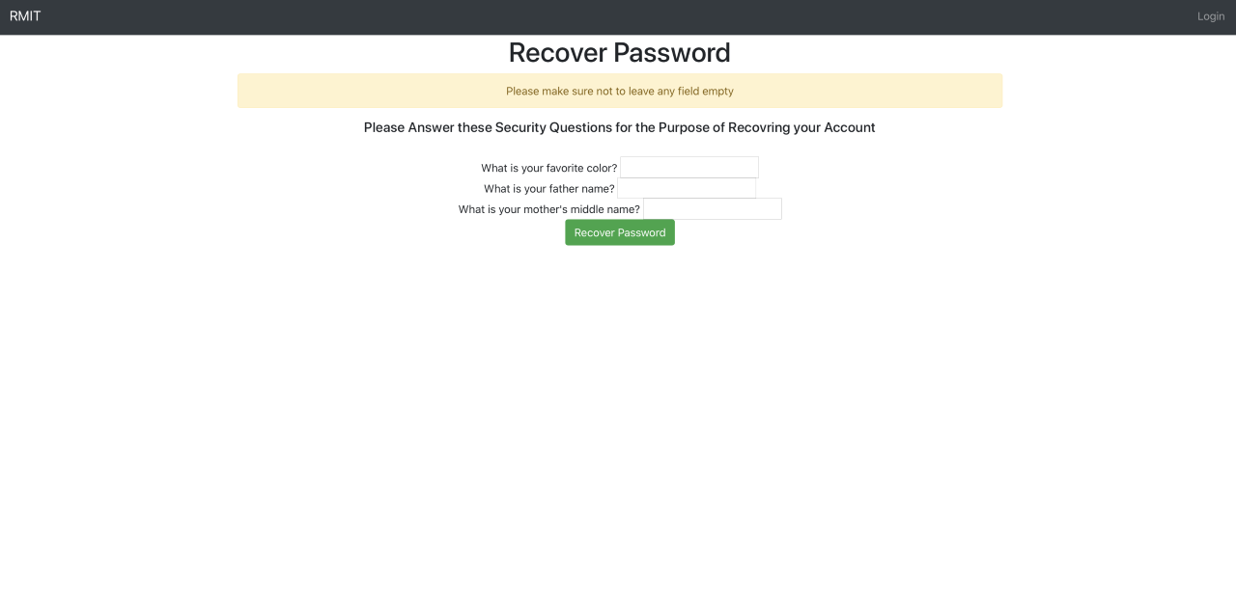

Slide 16
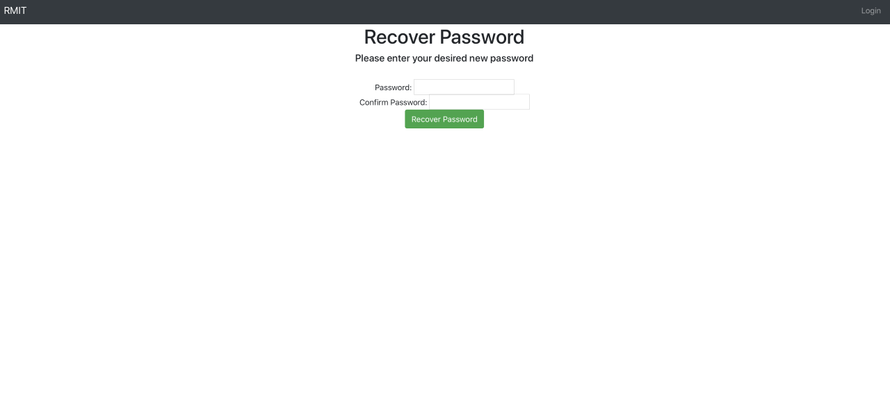

Slide 17
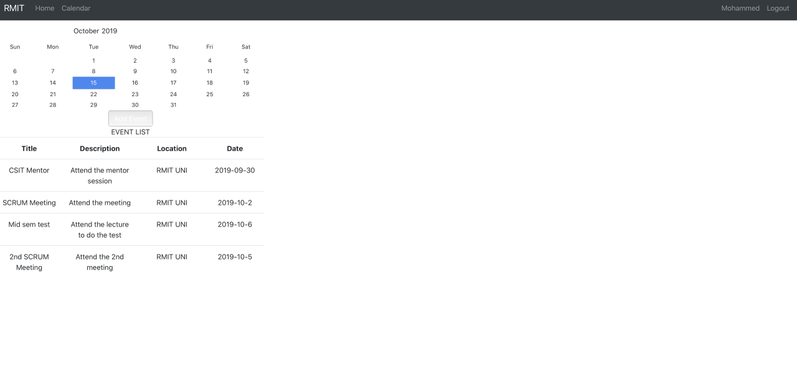

Slide 18
Project Retro

Slide 19
Project Retro
Things that went well
Front end and all attached aspects (front end Travis, front end data store, front end unit tests)
Documentation

Slide 20
Project Retro
Things that could’ve gone better
Time management
Communication
Back end IN GENERAL (Stunted communication)

Slide 21
Project Retro
Things that surprised us
Back end was harder than front end unlike the notion we were given
Integration was difficult for us because of stunted back end progress. However, the actual process of integration is not as hard as presumed

Slide 22
Project Retro
Lessons learnt
Adaptability
More frequent communication
Meetings
Online communication

Slide 23
Project Retro: Abandoned API
Original Plan
Events API, Calendar API and Admin API
Calendar API first
Events API second
Revised Plan after Sprint 1
Second API change
Events API → Calendar API
Reasons
React unfamiliarity (Beyond calendar)
Redo 2nd API documentation

Slide 24
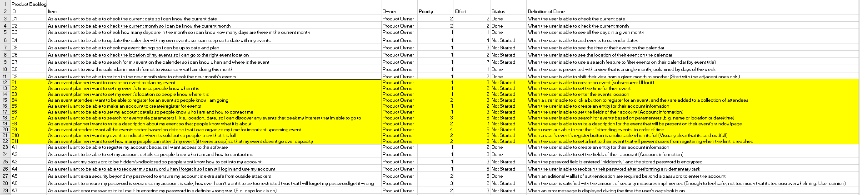

Slide 25
Project Retro: Github
Lack of proper (initial) use of git hub
Improper branch use
No git flow set up

Slide 26
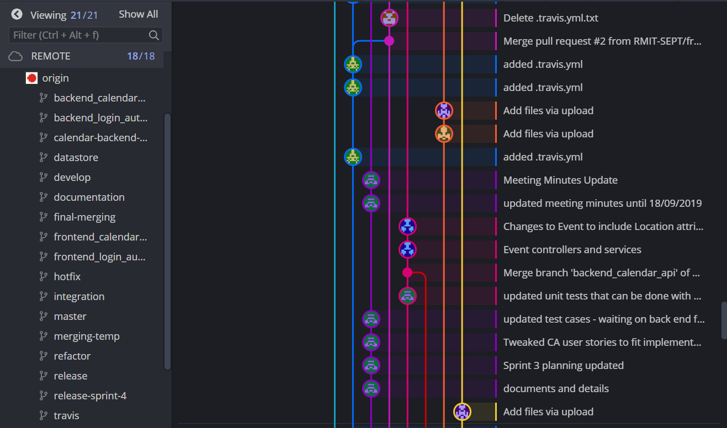

Slide 27
Project Retro: Trello
Lack of (Initial) proper use of trello
Sprint story points != 80
Multiple members on single trello card
No labelling
Misunderstanding of scrum techniques

Slide 28
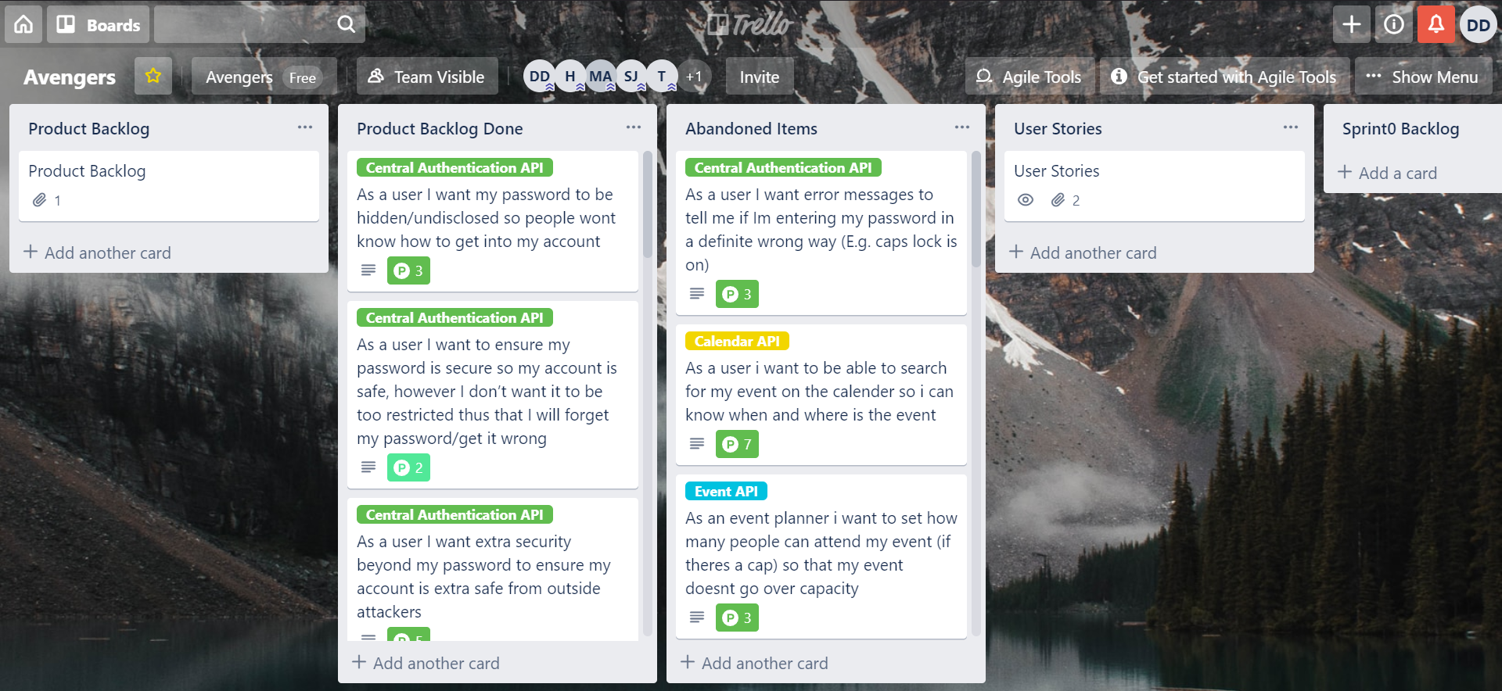

Slide 29
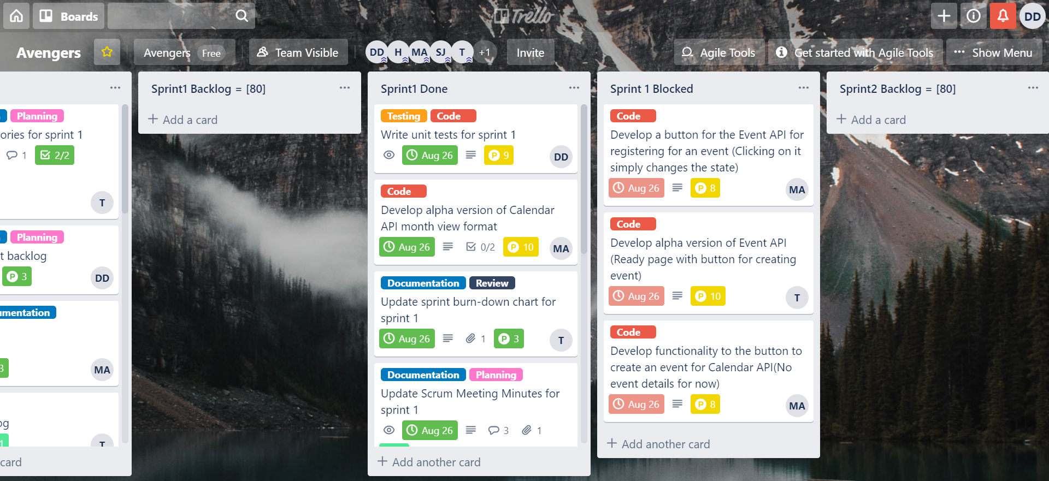

Slide 30
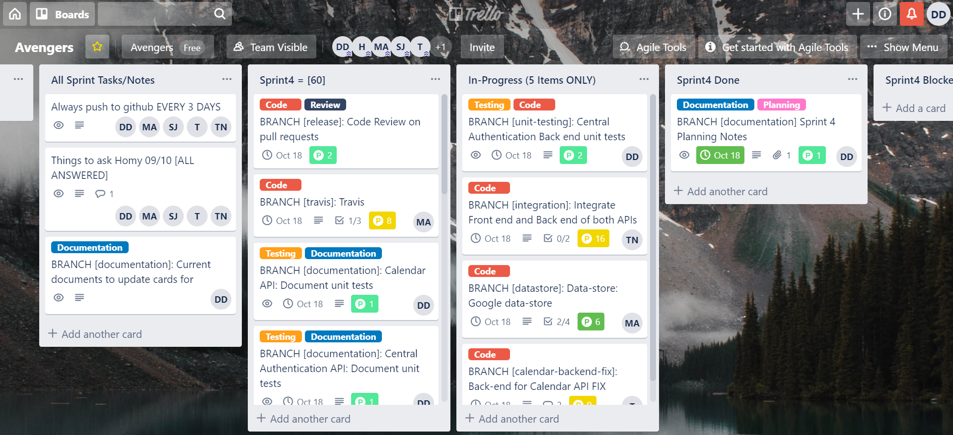

Slide 31
Project Retro: Communication
Poor communication (lack of substantial group meetings, missing members: resulted in stunted progress)
Requirements were not properly discussed/analysed, resulting in broken or improper delivery of code.
Incorrect implementation → redo → time lost

Slide 32



Slide 33
Conclusion

Slide 34
Conclusion
Fault of most projects
Human error in communication
Code and system errors stem from lack of communication in some fashion
E.g. Not properly discussing work between meetings resulted in redundant/incorrect work that needed to be redone
Time management
Not appropriately assign time to tasks (not realistic time goals in relation to the work load)
Highlighting that in the work force, software projects like this would require larger/full time dedication

Slide 35

Questions?

